Slide 1
Python Packages

Slide 2

Roadmap
Array Data Structure
Data Visualization
Pandas
Descriptive Analytics in Python

Slide 3


Array Data Structure
“Fighting with a large army under your command is nowise different from fighting with a small one: it is merely a question of instituting signs and signals.”
–Sun Tzu on the Art of War

Slide 4
Array Data Structure
Concepts
One-dimensional arrays
Final exam grades of six students
 |  |  | Length is 6
61 | 52.5 | 71 |  | 32.5 | 68 |  | 64

Slide 5
Array Data Structure
Concepts
One-dimensional arrays
Final exam grades of six students
6 students
Length is 6
71 32.5 68
61 52.5
64
Index of the item is 2

Slide 6
Array Data Structure
Concepts
Two-dimensional arrays
Grades of three components of six students
 | 3 columns
18 |  | 26 | 71
25 |  | 15.5 | 12
24 |  | 27 | 20
10 |  | 5.5 | 17
27 |  | 26 | 15
22 |  | 21 | 21
6 rows

Slide 7
Array Data Structure
Concepts
Two-dimensional arrays
Grades of three components of six students
3 components
 | 3 columns
18 | 26 | 71
25 | 15.5 | 12
24 | 27 | 20
10 | 5.5 | 17
27 | 26 | 15
22 | 21 | 21
6 rows
Row index is 3 Column index is 2
6 students

Slide 8
Array Data Structure
Concepts
N-dimensional arrays
3 columns
18 | 26 | 71
25 | 15.5 | 12
24 | 27 | 20
10 | 5.5 | 17
27 | 26 | 15
22 | 21 | 21
Length is 6
rows 6
61 52.5
Index of the item is 2
71 32.5 68 64
One-dimensional array
Row index is 3 Column index is 2
with 6 items
Two-dimensional array
with
6 × 3 = 18 items
Dimension number | Shape | Index | Item number
1
2
N
One number Two numbers
N numbers
One index Two indexes
N indexes
Shape
Shape[0] * Shape[1]
Shape[0] *…* Shape[N]

Slide 9

Array Data Structure
NumPy arrays
Import the NumPy package
import numpy as
.<function
np
np
name>

Slide 10
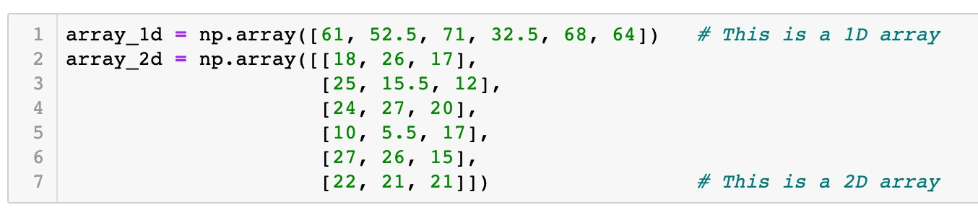
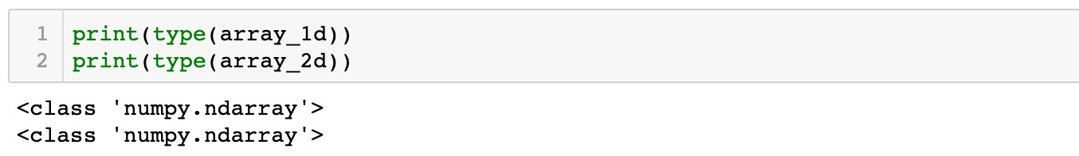

Array Data Structure
NumPy arrays
Create arrays from Python lists
Function
np.array()

Slide 11

Array Data Structure
NumPy arrays
Create arrays from Python lists
Function
np.array()
61 | 52.5 | 71 | 32.5 | 68 | 64

Slide 12
Array Data Structure
NumPy arrays
Create arrays from Python lists
Function
np.array()
18 | 26 | 71
25 | 15.5 | 12
24 | 27 | 20
10 | 5.5 | 17
27 | 26 | 15
22 | 21 | 21

Slide 13
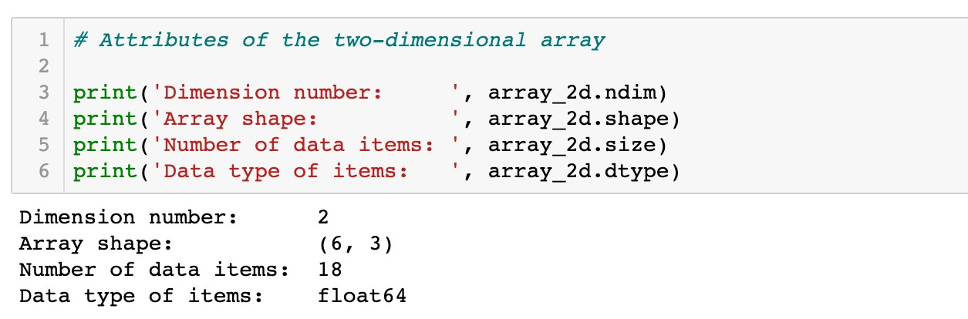
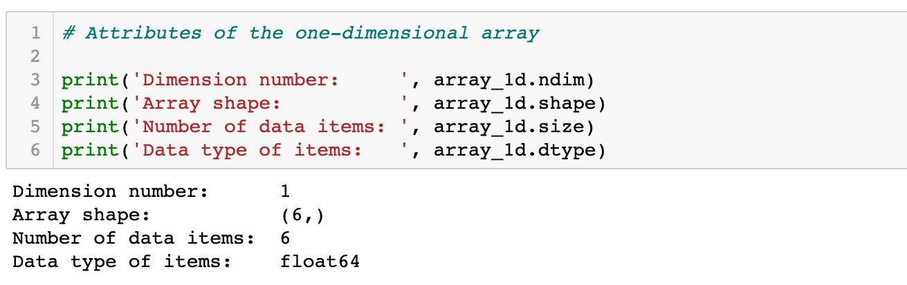
Array Data Structure
NumPy arrays
Create arrays from Python lists
Attributes of arrays

Slide 14

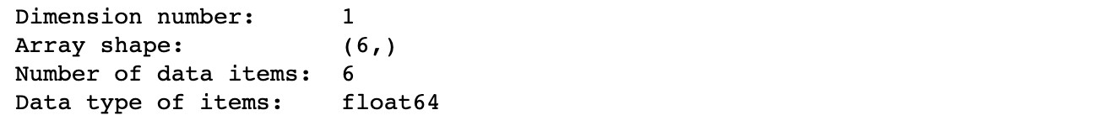
Array Data Structure
NumPy arrays
Create arrays from Python lists
Attributes of arrays
 |  | Length is 6
61 | 52.5 |  | 71 | 32.5 | 68 |  | 64
One-dimensional
array with 6 items

Slide 15
Array Data Structure
NumPy arrays
Create arrays from Python lists
Attributes of arrays
Length is 6
61 52.5
71 32.5 68 64
One-dimensional array
with 6 items
A tuple with one item

Slide 16

Array Data Structure
NumPy arrays
Create arrays from Python lists
Attributes of arrays
 |  | Length is 6
61 | 52.5 |  | 71 | 32.5 | 68 |  | 64
One-dimensional array
with 6 items

Slide 17
Array Data Structure
NumPy arrays
Create arrays from Python lists
Attributes of arrays
 |  | Length is 6
61 | 52.5 |  | 71 | 32.5 | 68 |  | 64
One-dimensional array
with 6 items
Data type: floating point numbers

Slide 18
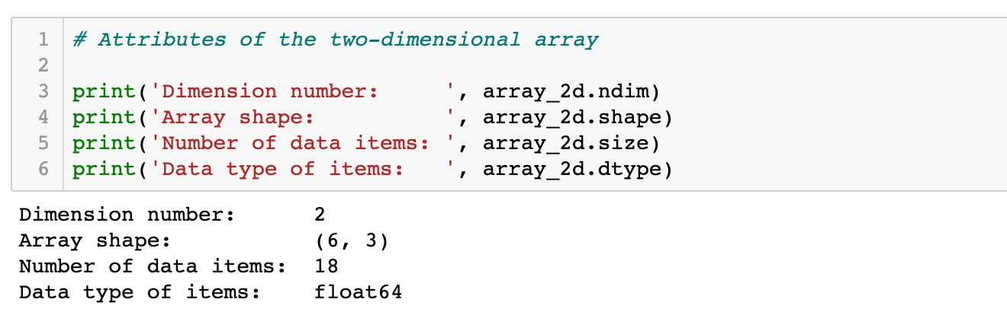
Array Data Structure
NumPy arrays
Create arrays from Python lists
Attributes of arrays

Slide 19
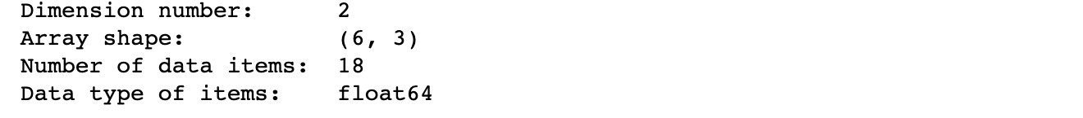
Array Data Structure
NumPy arrays
Create arrays from Python lists
Attributes of arrays
 | 3 columns
18 |  | 26 | 71
25 |  | 15.5 | 12
24 |  | 27 | 20
10 |  | 5.5 | 17
27 |  | 26 | 15
22 |  | 21 | 21
6 rows
Two-dimensional
array with 6 × 3 = 18 items

Slide 20


Array Data Structure
NumPy arrays
Create arrays from Python lists
Attributes of arrays
3 columns
18 |  | 26 | 71
25 |  | 15.5 | 12
24 |  | 27 | 20
10 |  | 5.5 | 17
27 |  | 26 | 15
22 |  | 21 | 21
ows r
6
Two-dimensional array with 6 × 3 = 18 items
axis 0

Slide 21

Array Data Structure
NumPy arrays
Create arrays from Python lists
Attributes of arrays
3 columns
18 | 26 | 71
25 | 15.5 | 12
24 | 27 | 20
10 | 5.5 | 17
27 | 26 | 15
22 | 21 | 21
ows r
6
Two-dimensional array with 6 × 3 = 18 items
axis 1

Slide 22

Array Data Structure
NumPy arrays
Create arrays from Python lists
Attributes of arrays
 | 3 columns
18 |  | 26 | 71
25 |  | 15.5 | 12
24 |  | 27 | 20
10 |  | 5.5 | 17
27 |  | 26 | 15
22 |  | 21 | 21
6 rows
Two-dimensional array
with 6 × 3 = 18 items

Slide 23
Array Data Structure
NumPy arrays
Create arrays from Python lists
Attributes of arrays
 | 3 columns
18 |  | 26 | 71
25 |  | 15.5 | 12
24 |  | 27 | 20
10 |  | 5.5 | 17
27 |  | 26 | 15
22 |  | 21 | 21
6 rows
Two-dimensional array with 6 × 3 = 18 items
Data type: floating point numbers

Slide 24
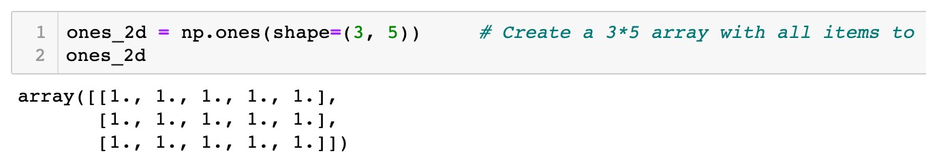
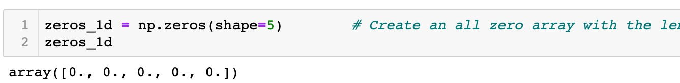
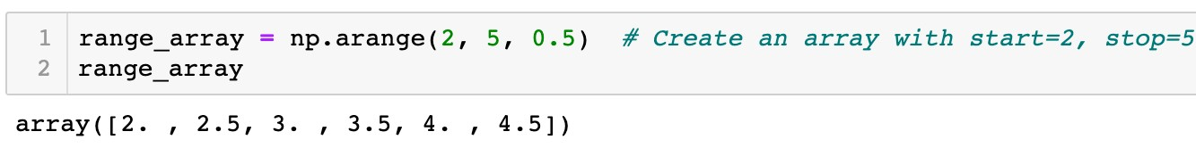
Array Data Structure
NumPy arrays
Create special arrays
A two-dimensional array: 3 rows and 5 columns
A one-dimensional array: length is 5
(start, stop, step)

Slide 25
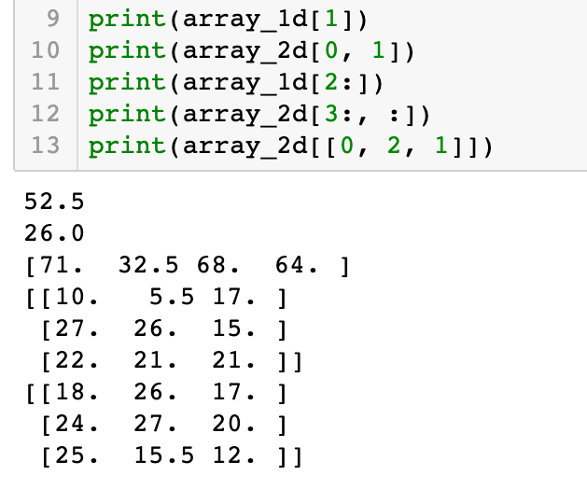
Array Data Structure
NumPy arrays
Indexing and slicing of arrays
Similar to type data
list
61 | 52.5 | 71 | 32.5 | 68 | 64
Index: 1

Slide 26
Array Data Structure
NumPy arrays
Indexing and slicing of arrays
Similar to type data
list
Row index: 0
Column index: 1
18 | 26 | 71
25 | 15.5 | 12
24 | 27 | 20
10 | 5.5 | 17
27 | 26 | 15
22 | 21 | 21

Slide 27
Array Data Structure
NumPy arrays
Indexing and slicing of arrays
Similar to type data
list
61 | 52.5 | 71 | 32.5 | 68 | 64
Index: 2:6:1

Slide 28
Array Data Structure
NumPy arrays
Indexing and slicing of arrays
Similar to type data
list
18 | 26 | 71
25 | 15.5 | 12
24 | 27 | 20
10 | 5.5 | 17
27 | 26 | 15
22 | 21 | 21
Row index: 3:6:1
Column index: 0:3:1

Slide 29
Array Data Structure
NumPy arrays
Indexing and slicing of arrays
Similar to type data
list
18 | 26 | 71
25 | 15.5 | 12
24 | 27 | 20
10 | 5.5 | 17
27 | 26 | 15
22 | 21 | 21
Row index: [0, 2, 1]
Column index: 0:3:1

Slide 30
Array Data Structure
NumPy arrays
Indexing and slicing of arrays
Similar to type data
list
18 | 26 | 71
25 | 15.5 | 12
24 | 27 | 20
10 | 5.5 | 17
27 | 26 | 15
22 | 21 | 21
Row index: [0, 2, 1]
Column index: 0:3:1
Take all columns if column index is no specified

Slide 31
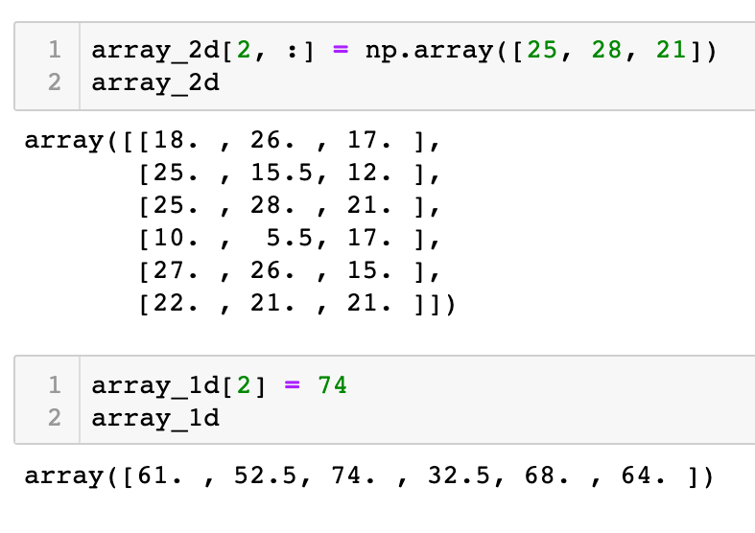
Array Data Structure
NumPy arrays
Indexing and slicing of arrays
Similar to type data
list
18 | 26 | 71
25 | 15.5 | 12
24 | 27 | 20
10 | 5.5 | 17
27 | 26 | 15
22 | 21 | 21
Items to be changed

Slide 32
Array Data Structure
NumPy arrays
Indexing and slicing of arrays
Similar to type data
list
18 | 26 | 71
25 | 15.5 | 12
25 | 28 | 21
10 | 5.5 | 17
27 | 26 | 15
22 | 21 | 21
New item values

Slide 33
Array Data Structure
NumPy arrays
Indexing and slicing of arrays
Similar to type data
list
Item to be changed
61 | 52.5 | 71 | 32.5 | 68 | 64

Slide 34
Array Data Structure
NumPy arrays
Indexing and slicing of arrays
Similar to type data
list
New item value
61 | 52.5 | 71 | 32.5 | 68 | 64

Slide 35
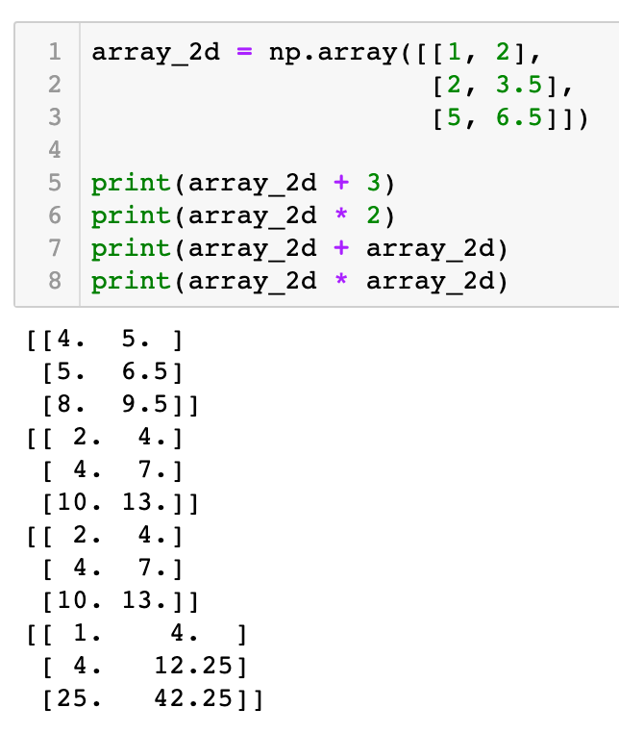
Array Data Structure
NumPy arrays
Element-wise arithmetic operations
An array and a scalar
1 | 2
2 | 3.5
5 | 6.5
4 | 5
5 | 6.5
8 | 9.5
+ 3 =
1 | 2
2 | 3.5
5 | 6.5
2 | 4
4 | 7
10 | 13
* 2 =

Slide 36
Array Data Structure
NumPy arrays
Element-wise arithmetic operations
An array and a scalar
1 | 2
2 | 3.5
5 | 6.5
1 | 2
2 | 3.5
5 | 6.5
2 | 4
4 | 7
10 | 13
+
=
1 | 2
2 | 3.5
5 | 6.5
1 | 2
2 | 3.5
5 | 6.5
1 | 4
4 | 12.25
25 | 42.25
*
=

Slide 37

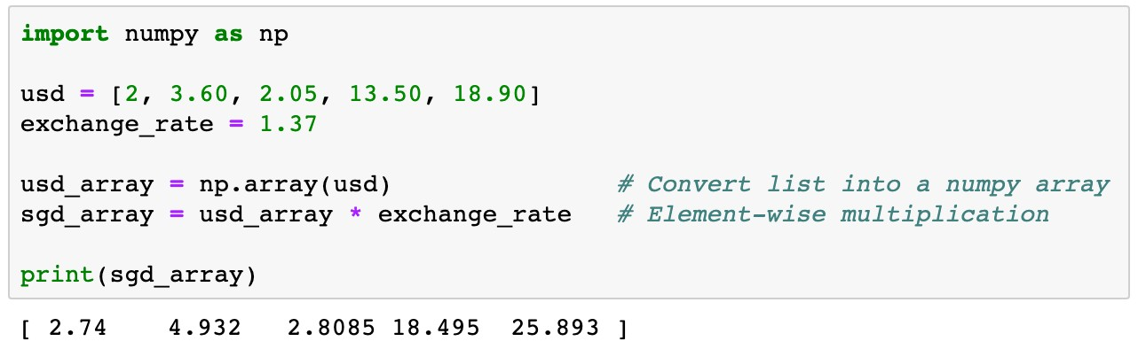
Array Data Structure
NumPy arrays
Element-wise arithmetic operations
Example 1
usd is a list of containing five money transactions in US dollars. Transfer each transaction into Singapore dollars.

Slide 38

Array Data Structure
NumPy arrays
Element-wise arithmetic operations
2 | 3.60 | 2.05 | 13.50 | 18.90

Slide 39

Array Data Structure
NumPy arrays
Element-wise arithmetic operations
2 | 3.60 | 2.05 | 13.50 | 18.90
* 1.37

Slide 40
Array Data Structure
NumPy arrays
Element-wise arithmetic operations
2.74 | 4.932 | 2.8085 | 18.495 | 25.893

Slide 41
Array Data Structure
NumPy arrays
Element-wise arithmetic operations
More concise
Easier to read
Faster to execute than loops

Slide 42

Array Data Structure
NumPy arrays
Element-wise arithmetic operations
Example 2
The discrete distribution information of two types of newspapers is stored in a two-dimensional array distr. The first row represents the probabilities of each weather condition, the second and third rows give the corresponding newspaper demands. Calculate 1) the expected newspaper demands; 2) the standard deviations of newspaper demands; and 3) the expected total profit with the given parameters

Slide 43
Array Data Structure
NumPy arrays
Element-wise arithmetic operations
Sunny Cloudy Raining
Thunderstorm
Haze
0.315 | 0.226 | 0.289 | 0.087 | 0.083
560 | 530 | 389 | 202 | 278
533 | 486 | 386 | 234 | 263
Probabilities
Paper1 Paper2
Two-dimensional array
distr

Slide 44
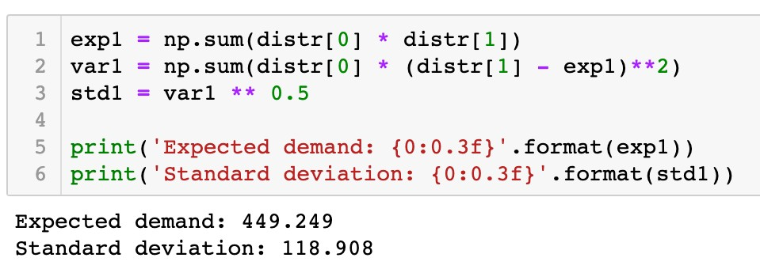
Array Data Structure
NumPy arrays
Element-wise arithmetic operations
Sunny Cloudy Raining
Thunderstorm
Haze
0.315 | 0.226 | 0.289 | 0.087 | 0.083
560 | 530 | 389 | 202 | 278
533 | 486 | 386 | 234 | 263
Probabilities
Paper1 Paper2
Two-dimensional array
distr

Slide 45
Array Data Structure
NumPy arrays
Element-wise arithmetic operations
Sunny Cloudy Raining
Thunderstorm
Haze
533 | 486 | 386 | 234 | 263
0.315 0.226 0.289 0.087 0.083
Probabilities
Paper1 Paper2
Two-dimensional array
560 530 389 202 278
distr

Slide 46
Array Data Structure
NumPy arrays
Element-wise arithmetic operations
Sunny Cloudy Raining
Thunderstorm
Haze
533 | 486 | 386 | 234 | 263
Probabilities
Paper1 Paper2
0.315 0.226 0.289 0.087 0.083
560 530 389 202 278
-exp1 | -exp1 | -exp1 | -exp1 | -exp1
560
530
389
202
278

Slide 47
Array Data Structure
NumPy arrays
Element-wise arithmetic operations
Sunny Cloudy Raining
Thunderstorm
Haze
533 | 486 | 386 | 234 | 263
Probabilities
Paper1 Paper2
0.315 0.226 0.289 0.087 0.083
560 530 389 202 278
( | -exp1)**2 | ( | -exp1)**2 | ( | -exp1)**2 | ( | -exp1)**2 | ( | -exp1)**2
560
530
389
202
278

Slide 48
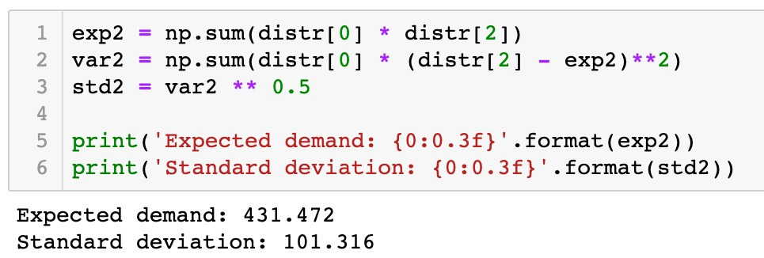
Array Data Structure
NumPy arrays
Element-wise arithmetic operations
Sunny Cloudy Raining
Thunderstorm
Haze
560 | 530 | 389 | 202 | 278
Probabilities
Paper1 Paper2
0.315 0.226 0.289 0.087 0.083
533 486 386 234 263
( | -exp2)**2 | ( | -exp2)**2 | ( | -exp2)**2 | ( | -exp2)**2 | ( | -exp2)**2
533
486
386
234
263

Slide 49



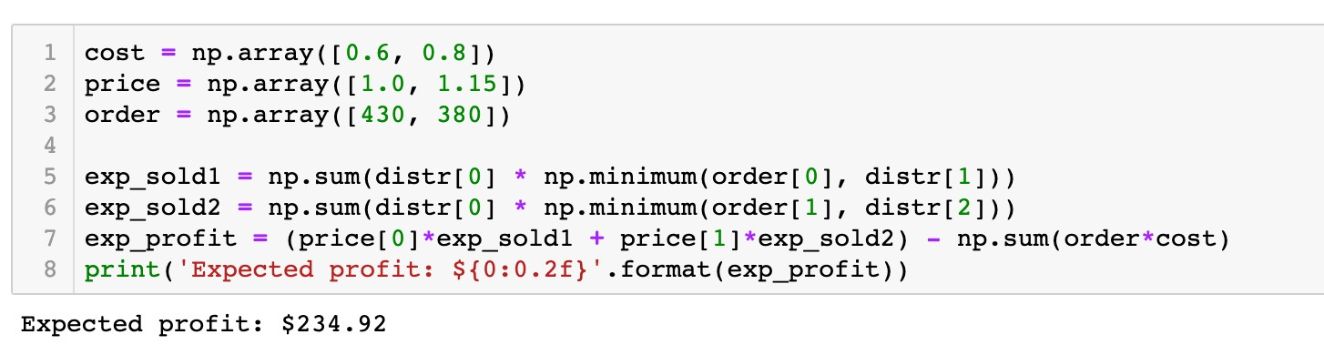
Array Data Structure
NumPy arrays
Element-wise arithmetic operations
distr[1]
560 530 389 202 278
order[0]
430
430 430 389 202 278

Slide 50

Array Data Structure
NumPy arrays
Element-wise arithmetic operations
distr[2]
533 486 386 234 263
order[1]
380
380 380 380 234 263

Slide 51



Array Data Structure
NumPy arrays
Element-wise arithmetic operations
cost
order
0.6 0.8
430 380
0.6*430 0.8*380

Slide 52
Array Data Structure
NumPy arrays
Element-wise arithmetic operations

Slide 53
Array Data Structure
NumPy arrays
Broadcasting
An array and a scalar
1 | 2
2 | 3.5
5 | 6.5
4 | 5
5 | 6.5
8 | 9.5
+
3
=
Two arrays of the same shape
1 | 2
2 | 3.5
5 | 6.5
1 | 2
2 | 3.5
5 | 6.5
2 | 4
4 | 7
10 | 13
+
=

Slide 54
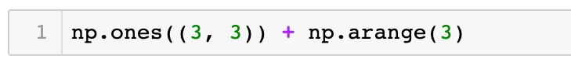
Array Data Structure
NumPy arrays
Broadcasting
Two arrays of diﬀerent same shapes
1 | 1 | 1
1 | 1 | 1
1 | 1 | 1
0 | 1 | 2
+
np.arange(3)
np.ones((3, 3))

Slide 55
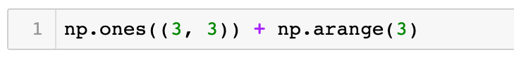
Array Data Structure
NumPy arrays
Broadcasting
Two arrays of diﬀerent same shapes
Broadcasting
Duplicate the smaller array
1 | 1 | 1
1 | 1 | 1
1 | 1 | 1
1 | 1 | 1
1 | 1 | 1
1 | 1 | 1
0 | 1 | 2
0 | 1 | 2
0 | 1 | 2
+
0 | 1 | 2
=
+
np.arange(3)
np.ones((3, 3))

Slide 56
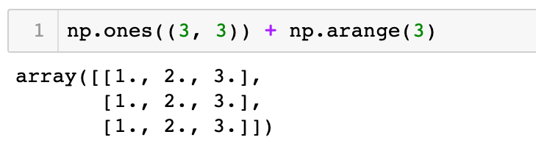
Array Data Structure
NumPy arrays
Broadcasting
Two arrays of diﬀerent same shapes
1 | 1 | 1
1 | 1 | 1
1 | 1 | 1
1 | 1 | 1
1 | 1 | 1
1 | 1 | 1
0 | 1 | 2
0 | 1 | 2
0 | 1 | 2
1 | 2 | 3
1 | 2 | 3
1 | 2 | 3
+
0 | 1 | 2
=
+
=
np.arange(3)
np.ones((3, 3))

Slide 57
Array Data Structure
NumPy arrays
Broadcasting
Two arrays of diﬀerent same shapes
0 | 1 | 2
np.arange(3)

Slide 58
Array Data Structure
NumPy arrays
Broadcasting
Two arrays of diﬀerent same shapes
1
0
3
1
Shape is changed from (3, ) to (3, 1)
2
np.arange(3).reshape
((3, 1)
)

Slide 59
Array Data Structure
NumPy arrays
Broadcasting
Two arrays of diﬀerent same shapes
0
1
+
0 | 1 | 2
2

Slide 60
Array Data Structure
NumPy arrays
Broadcasting
Two arrays of diﬀerent same shapes
Broadcasting Duplicate columns
0
0 | 0 | 0
1 | 1 | 1
2 | 2 | 2
0 | 1 | 2
0 | 1 | 2
0 | 1 | 2
1
+
0 | 1 | 2
=
+
2
Broadcasting Duplicate rows

Slide 61
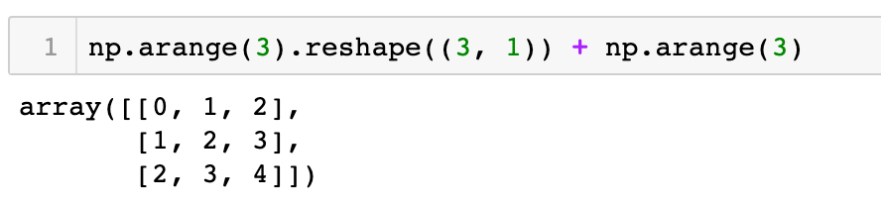
Array Data Structure
NumPy arrays
Broadcasting
Two arrays of diﬀerent same shapes
0
0 | 0 | 0
1 | 1 | 1
2 | 2 | 2
0 | 1 | 2
0 | 1 | 2
0 | 1 | 2
0 | 1 | 2
1 | 2 | 3
2 | 3 | 4
1
+
0 | 1 | 2
=
+
=
2

Slide 62
Array Data Structure
NumPy arrays
Broadcasting
An array and a scalar, interpreted by broadcasting
Broadcasting Duplicate items
0 | 1 | 2
+
5
=
0 | 1 | 2
+
5 | 5 | 5

Slide 63
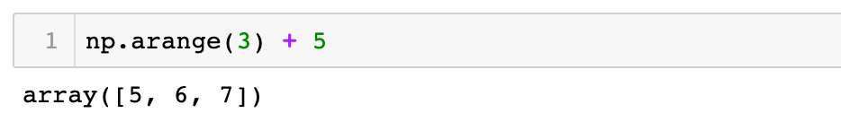
Array Data Structure
NumPy arrays
Broadcasting
An array and a scalar, interpreted by broadcasting
✓
0 | 1 | 2
+
5
=
0 | 1 | 2
+
5 | 5 | 5
=
5 | 6 | 7

Slide 64
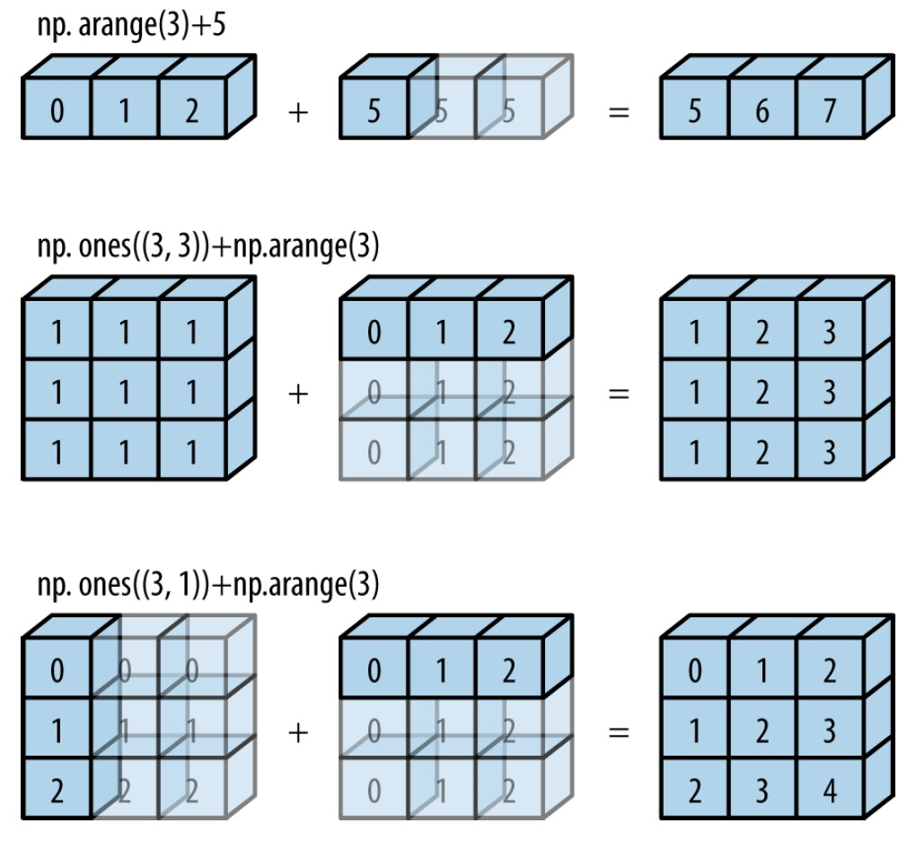
Array Data Structure
NumPy arrays
Broadcasting

Slide 65
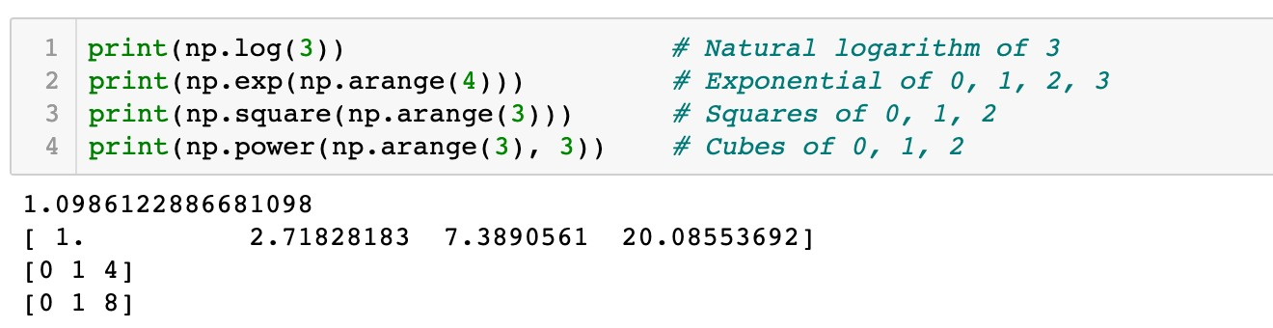
Array Data Structure
NumPy arrays
Functions and array methods
Math functions

Slide 66
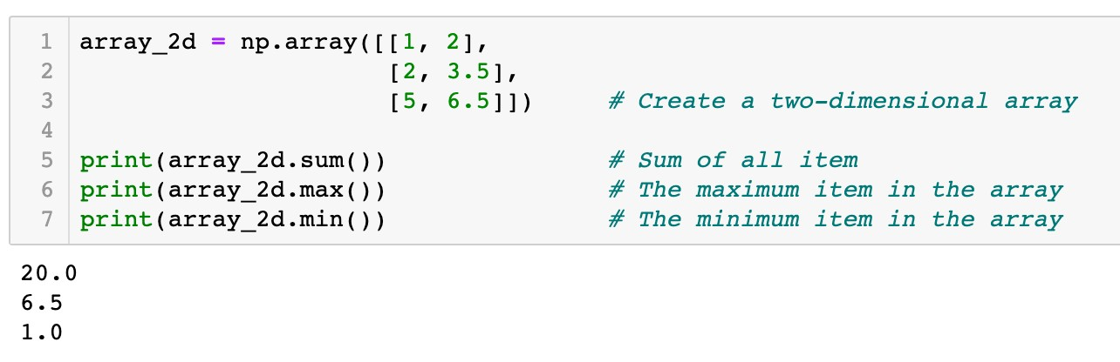
Array Data Structure
NumPy arrays
Functions and array methods
Aggregation methods

Slide 67
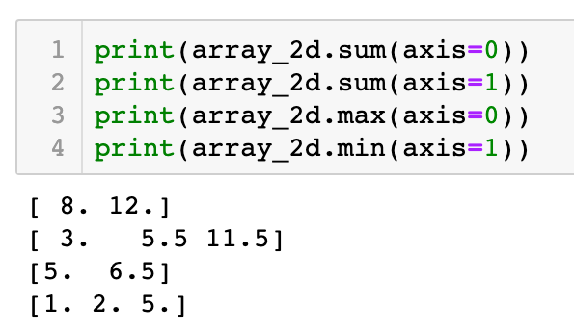
Array Data Structure
NumPy arrays
Functions and array methods
Aggregation methods
axis1
1 | 2
2 | 3.5
5 | 6.5
axis0

Slide 68
Array Data Structure
NumPy arrays
Functions and array methods
Aggregation methods
1 | 2
2 | 3.5
5 | 6.5
axis0
8.0 12.0

Slide 69
Array Data Structure
NumPy arrays
Functions and array methods
Aggregation methods
axis1
1 | 2
2 | 3.5
5 | 6.5
3
5.5
11.5

Slide 70
Array Data Structure
NumPy arrays
Functions and array methods
Aggregation methods
1 | 2
2 | 3.5
5 | 6.5
axis0
5 6.5

Slide 71
Array Data Structure
NumPy arrays
Functions and array methods
Aggregation methods
axis1
1 | 2
2 | 3.5
5 | 6.5
1.0
2.0
5.0

Slide 72
Array Data Structure
NumPy arrays
Functions and array methods
Example 2
The discrete distribution information of two types of newspapers is stored in a two-dimensional array distr. The first row represents the probabilities of each weather condition, the second and third rows give the corresponding newspaper demands. Calculate 1) the expected newspaper demands; 2) the standard deviations of newspaper demands; and 3) the expected total profit with the given parameters

Slide 73
Array Data Structure
NumPy arrays
Functions and array methods
Sunny Cloudy
Raining
Thunderstorm
Haze
0.315 | 0.226 | 0.289 | 0.087 | 0.083
560 | 530 | 389 | 202 | 278
533 | 486 | 386 | 234 | 263
Probabilities
Paper1 Paper2
Two-dimensional array
distr

Slide 74


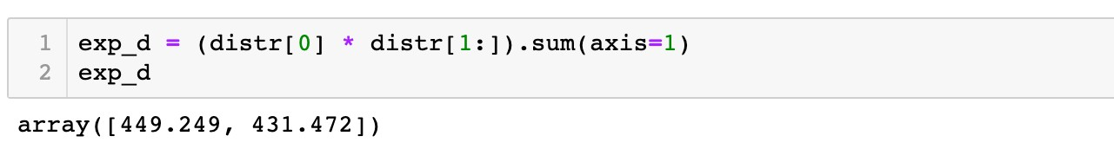
Array Data Structure
NumPy arrays
Functions and array methods
Sunny Cloudy
Raining
Thunderstorm
Haze
0.315 0.226 0.289 0.087 0.083
Probabilities
Paper1 Paper2
Two-dimensional array
*
560 530 389 202 278
533 486 386 234 263
distr
0.315 0.226 0.289 0.087 0.083
560 530 389 202 278
533 486 386 234 263

Slide 75

Array Data Structure
NumPy arrays
Functions and array methods
Sunny Cloudy
Raining
Thunderstorm
Haze
0.315 0.226 0.289 0.087 0.083
Probabilities
Paper1 Paper2
Two-dimensional array
*
Broadcasting
560 530 389 202 278
533 486 386 234 263
distr
0.315 0.226 0.289 0.087 0.083
0.315 0.226 0.289 0.087 0.083
560 530 389 202 278
533 486 386 234 263

Slide 76

Array Data Structure
NumPy arrays
Functions and array methods
Sunny Cloudy
Raining
Thunderstorm
Haze
0.315 | 0.226 | 0.289 | 0.087 | 0.083
560 | 530 | 389 | 202 | 278
533 | 486 | 386 | 234 | 263
Probabilities
Paper1 Paper2
Two-dimensional array
axis1
distr
0.315*560 0.226*530 0.289*389 0.087*202 0.083*278
0.315*533 0.226*486 0.289*386 0.087*234 0.083*263

Slide 77
Array Data Structure
NumPy arrays
Functions and array methods
Sunny Cloudy
Raining
Thunderstorm
Haze
0.315 | 0.226 | 0.289 | 0.087 | 0.083
560 | 530 | 389 | 202 | 278
533 | 486 | 386 | 234 | 263
Probabilities
Paper1 Paper2
Two-dimensional array
axis1
distr
0.315*560 0.226*530 0.289*389 0.087*202 0.083*278
0.315*533 0.226*486 0.289*386 0.087*234 0.083*263
449.249
431.472

Slide 78


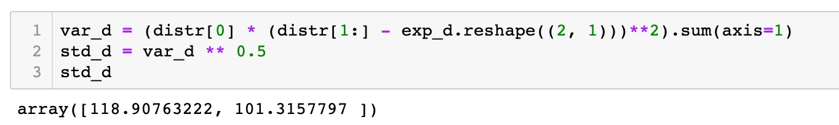
Array Data Structure
NumPy arrays
Functions and array methods
Sunny Cloudy
Raining
Thunderstorm
Haze
0.315 | 0.226 | 0.289 | 0.087 | 0.083
560 | 530 | 389 | 202 | 278
533 | 486 | 386 | 234 | 263
Probabilities
Paper1 Paper2
Two-dimensional array
distr
560 530 389 202 278
533 486 386 234 263
449.249
431.472
-

Slide 79

Array Data Structure
NumPy arrays
Functions and array methods
Sunny Cloudy
Raining
Thunderstorm
Haze
0.315 | 0.226 | 0.289 | 0.087 | 0.083
560 | 530 | 389 | 202 | 278
533 | 486 | 386 | 234 | 263
Probabilities
Paper1 Paper2
Two-dimensional array
distr
560 530 389 202 278
533 486 386 234 263
560 530 389 202 278
533 486 386 234 263
449.249 449.249 449.249 449.249 449.249
431.472 431.472 431.472 431.472 431.472
-
Broadcasting

Slide 80

Array Data Structure
NumPy arrays
Functions and array methods
Sunny Cloudy
Raining
Thunderstorm
Haze
0.315 | 0.226 | 0.289 | 0.087 | 0.083
560 | 530 | 389 | 202 | 278
533 | 486 | 386 | 234 | 263
Probabilities
Paper1 Paper2
Two-dimensional array
distr
560-449.249 530-449.249 389-449.249 202-449.249 278-449.249
533-431.472 486-431.472 386-431.472 234-431.472 263-431.472

Slide 81

Array Data Structure
NumPy arrays
Functions and array methods
Sunny Cloudy
Raining
Thunderstorm
Haze
0.315 | 0.226 | 0.289 | 0.087 | 0.083
560 | 530 | 389 | 202 | 278
533 | 486 | 386 | 234 | 263
Probabilities
Paper1 Paper2
Two-dimensional array
distr
(560-449.249)**2 (530-449.249)**2 (389-449.249)**2 (202-449.249)**2 (278-449.249)**2 (533-431.472)**2 (486-431.472)**2 (386-431.472)**2 (234-431.472)**2 (263-431.472)**2

Slide 82
Array Data Structure
NumPy arrays
Functions and array methods
Sunny Cloudy
Raining
Thunderstorm
Haze
560 | 530 | 389 | 202 | 278
533 | 486 | 386 | 234 | 263
0.315 0.226 0.289 0.087 0.083
Probabilities
Paper1 Paper2
Two-dimensional array
axis1
distr
(560-449.249)**2 (530-449.249)**2 (389-449.249)**2 (202-449.249)**2 (278-449.249)**2 (533-431.472)**2 (486-431.472)**2 (386-431.472)**2 (234-431.472)**2 (263-431.472)**2

Slide 83


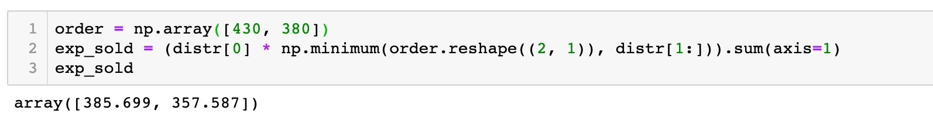
Array Data Structure
NumPy arrays
Functions and array methods
Sunny Cloudy
Raining
Thunderstorm
Haze
0.315 | 0.226 | 0.289 | 0.087 | 0.083
Probabilities
Paper1 Paper2
Two-dimensional array
560 530 389 202 278
533 486 386 234 263
distr
430
380
560 530 389 202 278
533 486 386 234 263

Slide 84
Array Data Structure
NumPy arrays
Functions and array methods
Sunny Cloudy
Raining
Thunderstorm
Haze
0.315 | 0.226 | 0.289 | 0.087 | 0.083
Probabilities
Paper1 Paper2
Two-dimensional array
560 530 389 202 278
533 486 386 234 263
distr
430 430 430 430 430
380 380 380 380 380
560 530 389 202 278
533 486 386 234 263
Broadcasting

Slide 85


Array Data Structure
NumPy arrays
Functions and array methods
Sunny Cloudy
Raining
Thunderstorm
Haze
560 | 530 | 389 | 202 | 278
533 | 486 | 386 | 234 | 263
0.315 0.226 0.289 0.087 0.083
Probabilities
Paper1 Paper2
Two-dimensional array
*
distr
0.315 0.226 0.289 0.087 0.083
430 430 389 202 278
380 380 380 234 263

Slide 86

Array Data Structure
NumPy arrays
Functions and array methods
Sunny Cloudy
Raining
Thunderstorm
Haze
560 | 530 | 389 | 202 | 278
533 | 486 | 386 | 234 | 263
0.315 0.226 0.289 0.087 0.083
Probabilities
Paper1 Paper2
Two-dimensional array
*
Broadcasting
distr
0.315 0.226 0.289 0.087 0.083
0.315 0.226 0.289 0.087 0.083
430 430 389 202 278
380 380 380 234 263

Slide 87

Array Data Structure
NumPy arrays
Functions and array methods
Sunny Cloudy
Raining
Thunderstorm
Haze
0.315 | 0.226 | 0.289 | 0.087 | 0.083
560 | 530 | 389 | 202 | 278
533 | 486 | 386 | 234 | 263
Probabilities
Paper1 Paper2
Two-dimensional array
axis1
distr
0.315*430 0.226*430 0.289*389 0.087*202 0.083*278
0.315*380 0.226*380 0.289*380 0.087*234 0.083*263
385.699
357.587

Slide 88
Roadmap
Array Data Structure
Data Visualization
Pandas
Descriptive Analytics in Python

Slide 89
Data Visualization

Slide 90

Data Visualization
Data Visualization Packages
Import the Matplotlib package
import
matplotlib.pyplot as
plt
plt
.<function name>
Other package
Plotly
Seaborn

Slide 91

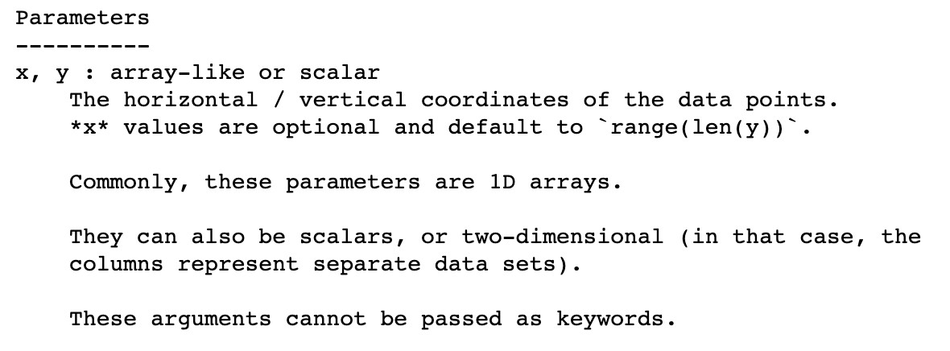
Data Visualization
Functions
Line plot
plot()
,
scatter()
, and
bar()
✓
help()
information of
plot()

Slide 92

Data Visualization
Functions
Line plot
plot()
,
scatter()
, and
bar()
Example 3
Plot the graph of an exponential function y = exp(x), where
x = 0,1,2,3,4,5.

Slide 93
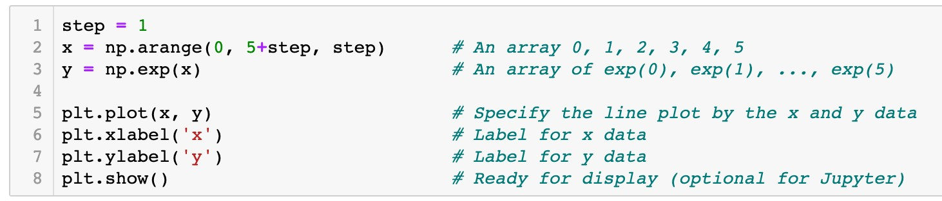
Data Visualization
Functions
Line plot
plot()
,
scatter()
, and
bar()
Example 3
Plot the graph of an exponential function y = exp(x), where
x = 0,1,2,3,4,5.

Slide 94
Data Visualization
Functions
Line plot
plot()
,
scatter()
, and
bar()
x
0 1 2 3 4 5

Slide 95
Data Visualization
Functions
Line plot
plot()
,
scatter()
, and
bar()
x
0 1 2 3 4 5
y
exp(0) exp(1) exp(2) exp(3) exp(4) exp(5)

Slide 96

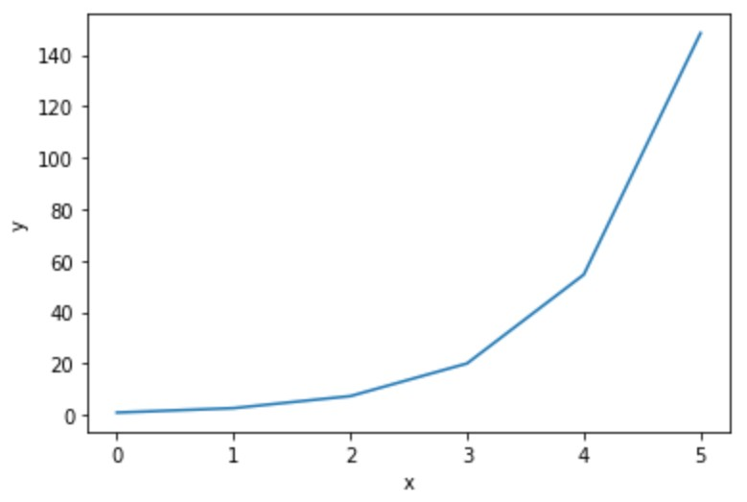
Data Visualization
Functions
Line plot
plot()
,
scatter()
, and
bar()
x
0 1 2 3 4 5
y
exp(0) exp(1) exp(2) exp(3) exp(4) exp(5)
(x[0], y[0])

Slide 97
Data Visualization
Functions
Line plot
plot()
,
scatter()
, and
bar()
x
0 1 2 3 4 5
y
exp(0) exp(1) exp(2) exp(3) exp(4) exp(5)
(x[1], y[1])

Slide 98
Data Visualization
Functions
Line plot
plot()
,
scatter()
, and
bar()
x
0 1 2 3 4 5
y
exp(0) exp(1) exp(2) exp(3) exp(4) exp(5)
(x[2], y[2])

Slide 99
Data Visualization
Functions
Line plot
plot()
,
scatter()
, and
bar()
x
0 1 2 3 4 5
y
exp(0) exp(1) exp(2) exp(3) exp(4) exp(5)
(x[5], y[5])

Slide 100
Data Visualization
Functions
Line plot
plot()
,
scatter()
, and
bar()
x
0 1 2 3 4 5
y
exp(0) exp(1) exp(2) exp(3) exp(4) exp(5)

Slide 101
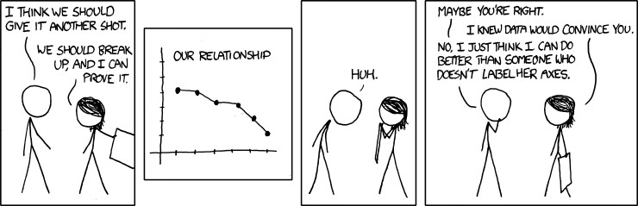
Data Visualization
Functions
plot()
,
scatter()
, and
bar()

Slide 102
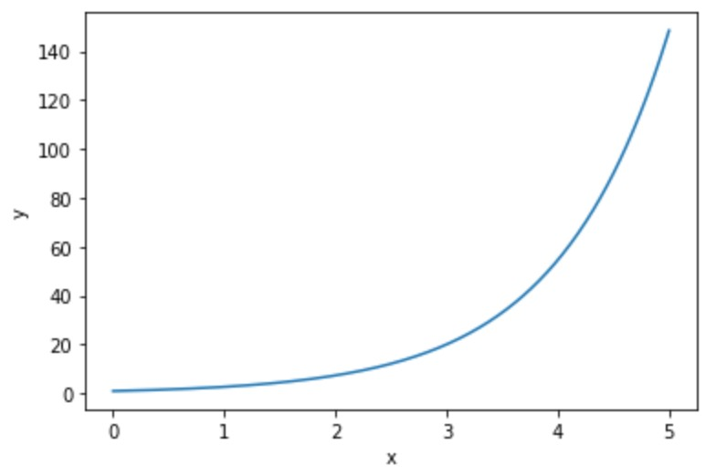
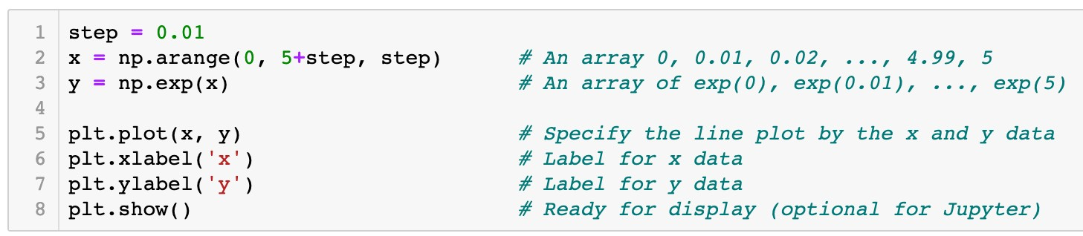
Data Visualization
Functions
Line plot
plot()
,
scatter()
, and
bar()
x
0 0.01 0.02 … 5
y
exp(0) exp(0.01) exp(0.02) … exp(5)

Slide 103
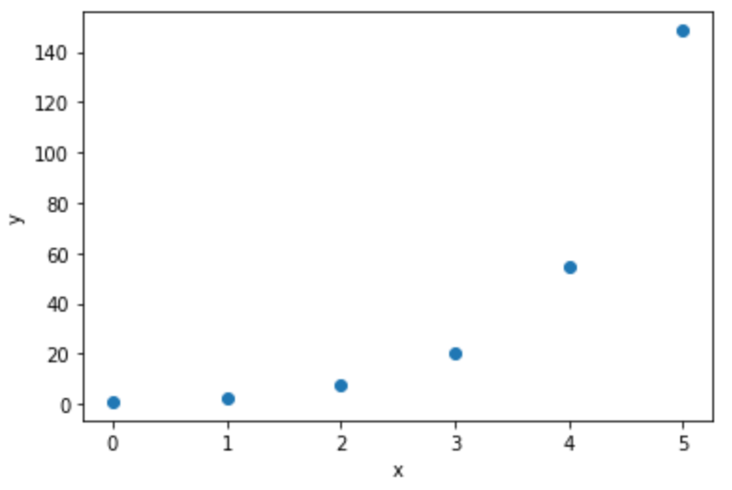
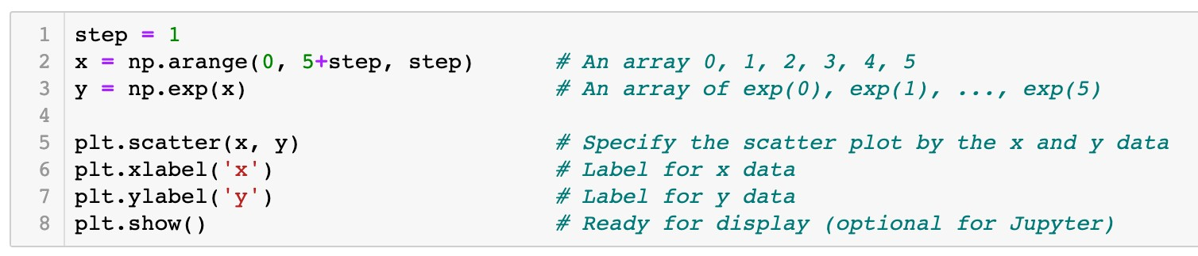
Data Visualization
Functions
plot()
,
scatter()
, and
bar()
Scatter plot
x
0 1 2 3 4 5
y
exp(0) exp(1) exp(2) exp(3) exp(4) exp(5)

Slide 104
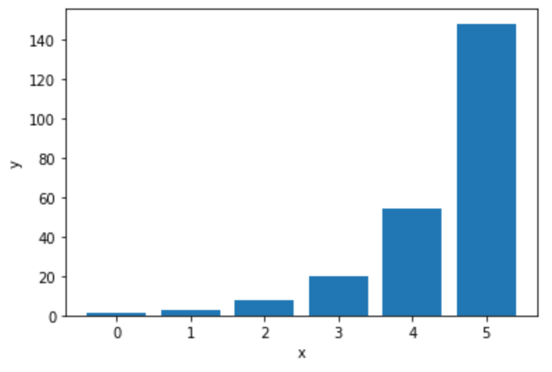
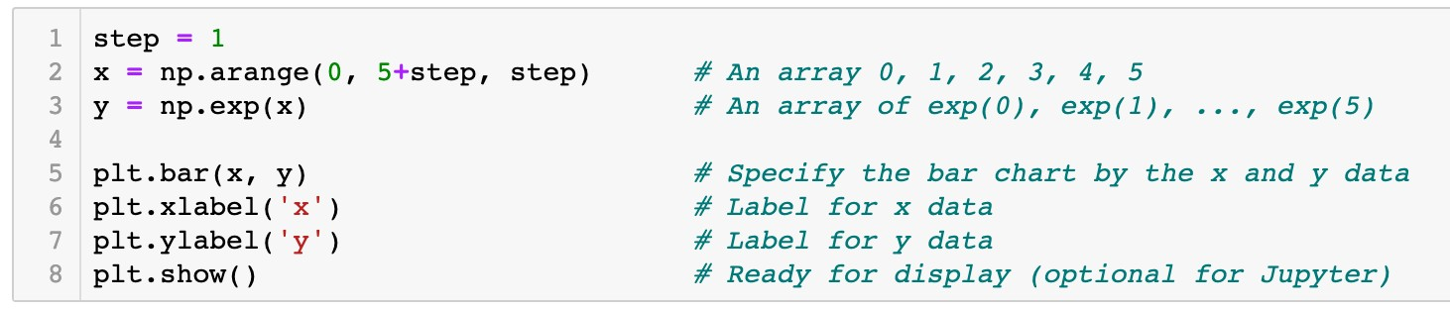
Data Visualization
Functions
plot()
,
scatter()
, and
bar()
Bar graph
x
0 1 2 3 4 5
y
exp(0) exp(1) exp(2) exp(3) exp(4) exp(5)

Slide 105

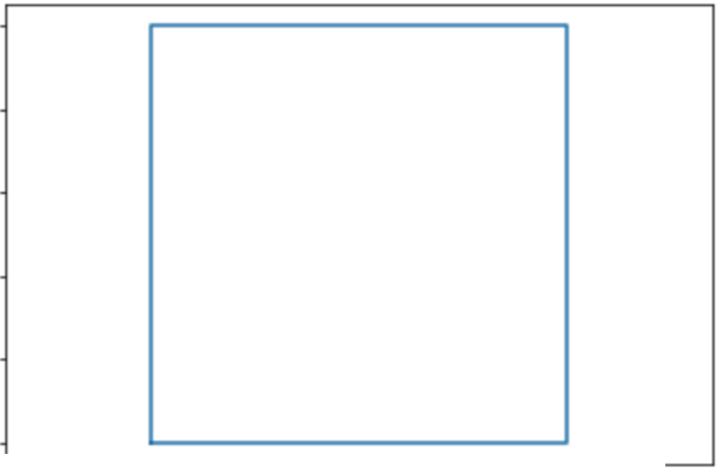
Data Visualization
Question
Which of the following code plots a square as the graph shows?
A.plt.plot([O , 0, 1, 1, O ],
[ 0 '
1, 0, 1, O ])
B. plt.plot([O , 1, 1, 0, O ], _{[ 0 '}
0 , 1, 1, 0 ] )
c. plt.plot([O , 1, 1, 0]' [0'o , 1, 11 )
D. plt.plot([O , 1, 1, O ], [O , 1, 1, O 1 )
LO
08
06
04
02
00
-0 2
00
02 04
06
08 LO
L2

Slide 106
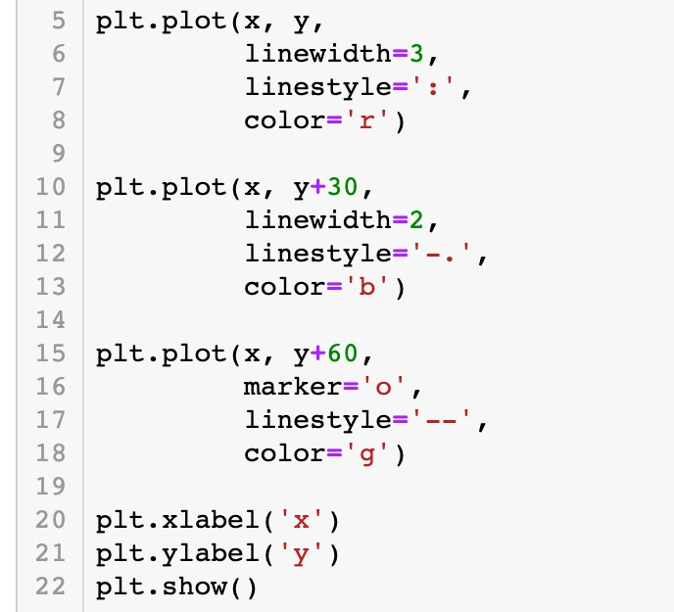
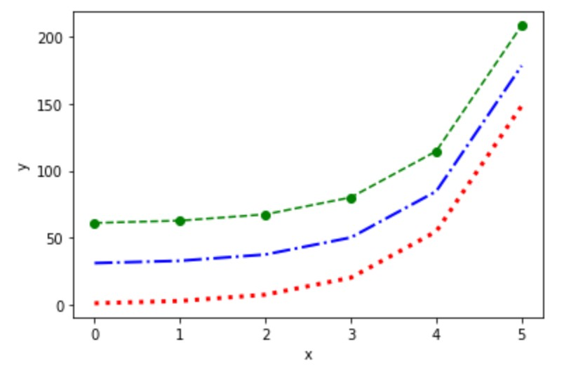
Data Visualization
Configuration of plots and figures
Specify the line plot by keyword arguments

Slide 107
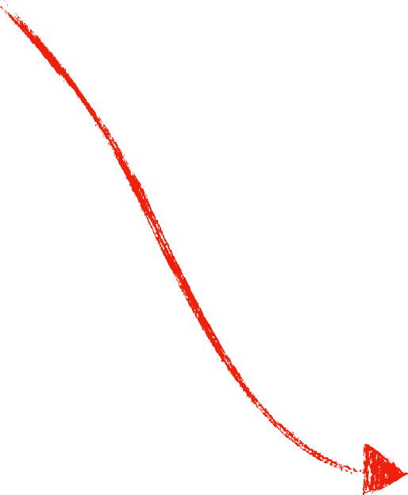
Data Visualization
Configuration of plots and figures
Specify the line plot by keyword arguments
Line width is 3 Dotted line
Line color is red

Slide 108

Data Visualization
Configuration of plots and figures
Specify the line plot by keyword arguments
Line width is 2 Dash-dotted line Line color is blue

Slide 109

Data Visualization
Configuration of plots and figures
Specify the line plot by keyword arguments
Circle marker Dashed line
Line color is green

Slide 110
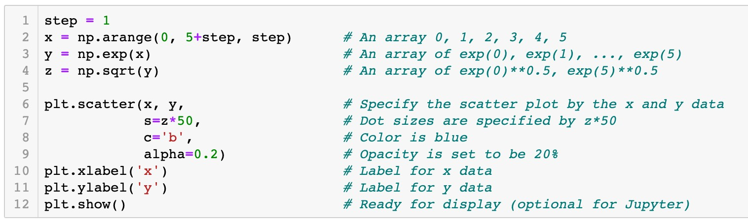
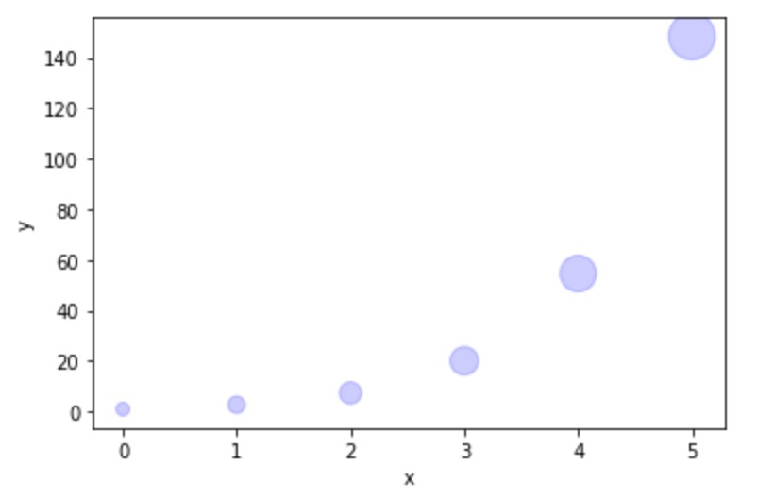
Data Visualization
Configuration of plots and figures
Specify the scatter plot by keyword arguments
Size of scatter dots

Slide 111
Data Visualization
Configuration of plots and figures
Specify the scatter plot by keyword arguments
Color of scatter dots

Slide 112
Data Visualization
Configuration of plots and figures
Specify the scatter plot by keyword arguments
Opacity of dots

Slide 113
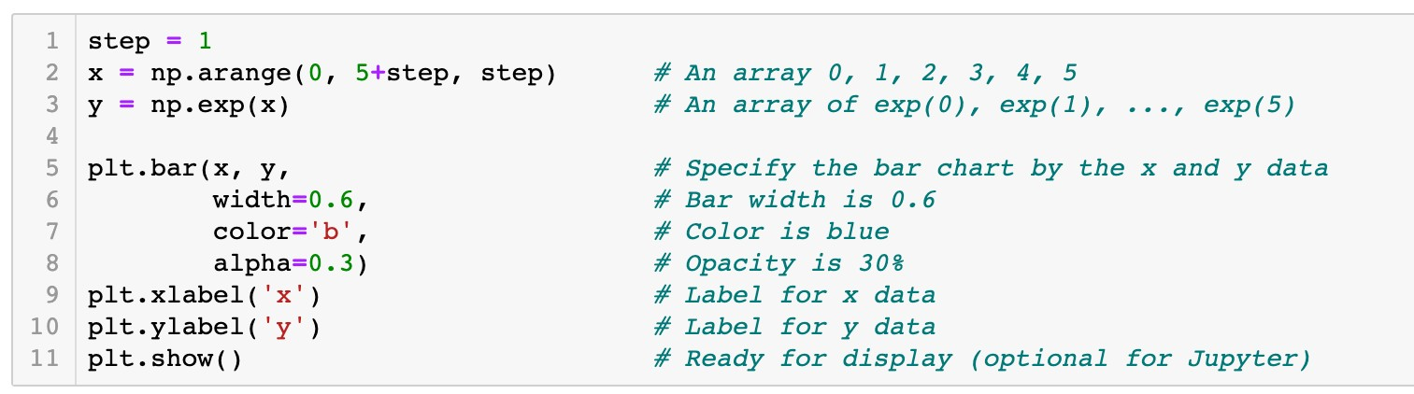
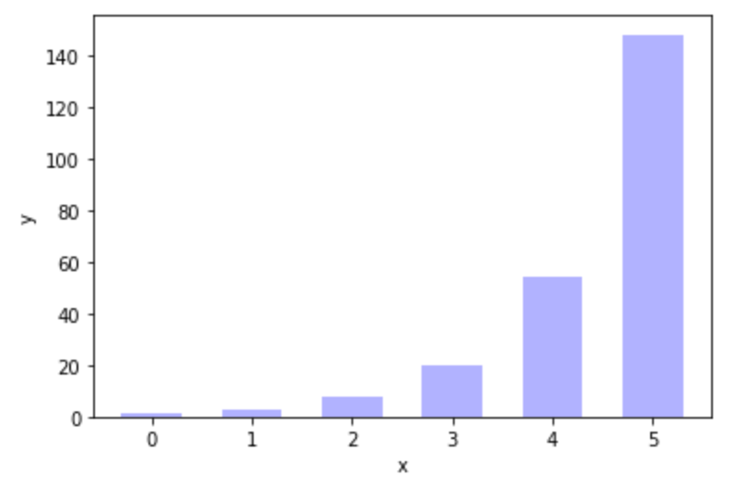
Data Visualization
Configuration of plots and figures
Specify the bar graph by keyword arguments
Bar width is 0.6

Slide 114
Data Visualization
Configuration of plots and figures
Specify the bar graph by keyword arguments
Color of bar graph

Slide 115
Data Visualization
Configuration of plots and figures
Specify the bar graph by keyword arguments
Opacity of bar graph

Slide 116
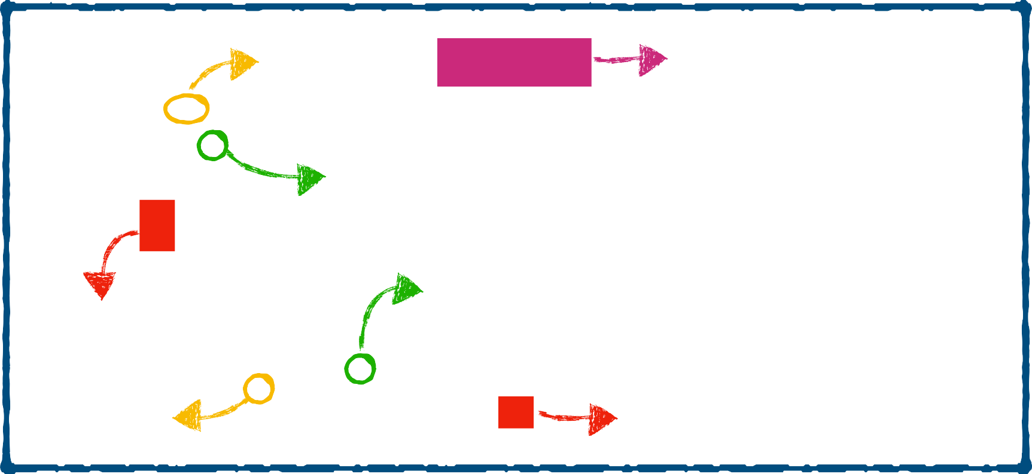
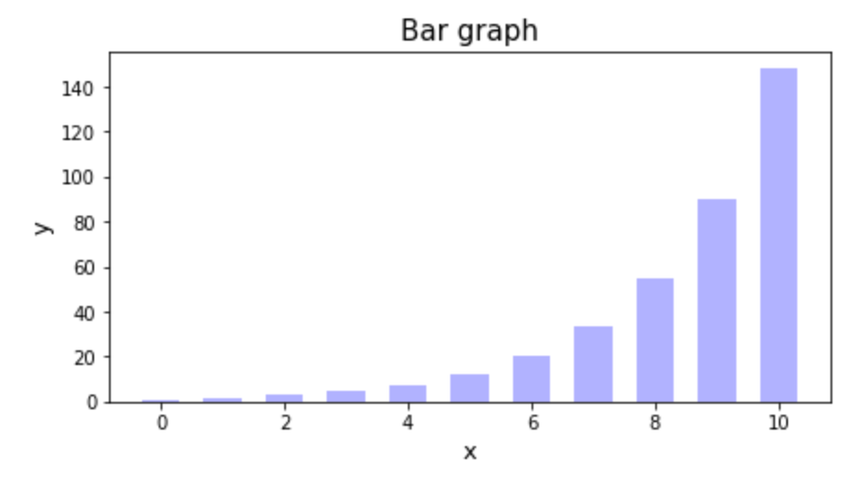
Data Visualization
Configuration of plots and figures
Components of a figure
Figure
yticklabel
title
yticks
xticks
ylabel
xticklabel
xlabel

Slide 117
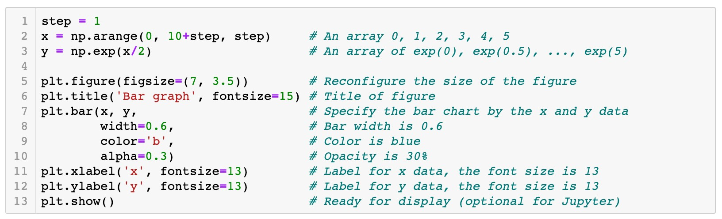


Data Visualization
Configuration of plots and figures
Attributes of a figure

Slide 118

Data Visualization
Configuration of plots and figures
Attributes of a figure
7
3.5

Slide 119
Data Visualization
Configuration of plots and figures
Attributes of a figure

Slide 120
Data Visualization
Configuration of plots and figures
Attributes of a figure

Slide 121



Data Visualization
Labeling plots and the function
legend()
legend

Slide 122



Data Visualization
Labeling plots and the function
Connection between plots and labels
legend()
legend

Slide 123


Data Visualization
Example 5
The discrete distribution information of two types of newspapers is stored in the dictionary distr_d ict. Use a bar graph to show the demands of these two types of
newspapers under different weather conditions.
{'weather' : ['Sunny', 'Cloudy', 'Raining', 'Thunderstorm',
'probs': [0.315, 0.226, 0.289, 0.087, 0.083],
'paperl': [560, 530, 389, 202, 278],
'paper2': [533, 486, 386, 234, 263]}
'Haze'],

Slide 124

Data Visualization
Array 0, 1, 2, …, 4

Slide 125
Data Visualization
Configure the size of figure

Slide 126

Data Visualization
width
x[i]

Slide 127
Data Visualization
-0.5*width
width
x[i]

Slide 128
Data Visualization
+0.5*width
width
x[i]

Slide 129


Data Visualization

Slide 130

Data Visualization

Slide 131



Data Visualization
Replace integer x-ticks by strings
0 1 2 3 4

Slide 132


Python Packages
Packages NumPy and Matplotlib
Joan Watson: “How did you know he had an affair?”
–Elementary, Season 1, Episode 1

Slide 133
Python Packages
Packages NumPy and Matplotlib
Joan Watson: “How did you know he had an affair?”
Sherlock Holmes: “Google.
Well, not everything is deducible.”
–Elementary, Season 1, Episode 1

Slide 134







Python Packages
Packages NumPy and Matplotlib
‣
Matplotlib
thumbnail gallery: examples and demos

Slide 135
Roadmap
Array Data Structure
Data Visualization
Pandas
Descriptive Analytics in Python

Slide 136

“It is a capital mistake to theorize before one has data. Insensibly one begins to twist facts to suit theories, instead of theories to suit facts.”
–Sherlock Holmes, A Scandal in Bohemia

Slide 137


Datasets
Data representation
Example 1
The data table contains a cross-sectional dataset on a number of working individuals for the year 1976. Explore the dataset to gain some basic knowledge of the historical data.

Slide 138


Datasets
Data representation
Variables (fields/attributes) as column labels
Years of education Average hourly
wage ($)
Years of working
experience
Gender
Marriage status

Slide 139
Datasets
Data representation
Variables (fields/attributes) as column labels
Observations (cases/records) as rows

Slide 140


Datasets
Data representation
Column index (label)
Row index (label)
Column index
Row index

Slide 141
Datasets
Types of variables
Numerical data
Categorical data
Numerical data Categorical data

Slide 142

Datasets
Types of variables
Numerical (quantitative) data
Categorical (qualitative) data
Numerical data Categorical data

Slide 143
Pandas for Data Analysis
Introduction to Pandas
Labels for variables (or observations)
Heterogenous data
Possible missing values

Slide 144
Pandas for Data Analysis
Introduction to Pandas
pd
import pandas as
.<function name>
pd

Slide 145


Pandas for Data Analysis
The
pandas.Series
data structure
A one-dimensional array of indexed data
Create a
pandas.Series
object

Slide 146




Pandas for Data Analysis
The
pandas.Series
data structure
A one-dimensional array of indexed data
Create a
pandas.Series
object

Slide 147


Pandas for Data Analysis
The
pandas.Series
data structure
A one-dimensional array of indexed data
Create a
pandas.Series
object
Values
Indices
exper.values
exper.index

Slide 148






Pandas for Data Analysis
The
pandas.Series
data structure
Indexing and slicing of
pandas.Series
objects via brackets
[]
Label based indices
wage
exper
0
1
2
3
4
5
0
1
2
3
4
5
Integer-position based indices

Slide 149

Pandas for Data Analysis
The
pandas.Series
data structure
Indexing and slicing of
pandas.Series
objects via brackets
[]
Label based indices are the same as integer-position based indices
wage
0
1
Integer-position based indices
2
3
4
5

Slide 150
Pandas for Data Analysis
The
pandas.Series
data structure
Indexing and slicing of
pandas.Series
objects via brackets
[]
Label based indices are the same as integer-position based indices
wage
0
1
2
Integer-position based indices
3
4
5

Slide 151
Pandas for Data Analysis
The
pandas.Series
data structure
Indexing and slicing of
pandas.Series
objects via brackets
[]
Label based indices are the same as integer-position based indices
wage
-6 |  | 0
-5 |  | 1
-4 |  | 2
-3 |  | 3
Integer-position based indices
-2 4
-1 5

Slide 152

Pandas for Data Analysis
The
pandas.Series
data structure
Indexing and slicing of
pandas.Series
objects via brackets
[]
Label based indices diﬀerent from integer-position based indices
exper
0
1
2
Label based indices
3
4
5

Slide 153
Pandas for Data Analysis
The
pandas.Series
data structure
Indexing and slicing of
pandas.Series
objects via brackets
[]
Label based indices diﬀerent from integer-position based indices
exper
0
1
2
Label based indices
3
4
5

Slide 154

Pandas for Data Analysis
The
pandas.Series
data structure
Indexing and slicing of
pandas.Series
objects via brackets
[]
Label based indices diﬀerent from integer-position based indices
exper
0
1
2
Label based indices
3
4
5

Slide 155
Pandas for Data Analysis
The
pandas.Series
data structure
Indexing and slicing of
pandas.Series
objects via brackets
[]
Label based indices diﬀerent from integer-position based indices
exper
0
1
2
Label based indices
3
4
5

Slide 156

Pandas for Data Analysis
The
pandas.Series
data structure
Indexing and slicing of
pandas.Series
objects via brackets
[]
Label based indices diﬀerent from integer-position based indices
exper
0
1
2
Label based indices
3
Notes
4
5
In the slicing expressions for label based indices, the
item indexed by stop are included in the selection. This is different from the list style slicing syntax we learned before.

Slide 157
Pandas for Data Analysis
The
pandas.Series
data structure
Indexing and slicing of
pandas.Series
objects via brackets
[]
Label based indices diﬀerent from integer-position based indices
exper
0
1
2
Label based indices
3
4
5

Slide 158

Pandas for Data Analysis
The
pandas.Series
data structure
Indexing and slicing of
pandas.Series
objects via brackets
[]
Label based indices diﬀerent from integer-position based indices
exper
0
1
Integer-position based indices
2
3
4
5

Slide 159
Pandas for Data Analysis
The
pandas.Series
data structure
Indexing and slicing of
pandas.Series
objects via brackets
[]
Label based indices diﬀerent from integer-position based indices
exper
0
1
Integer-position based indices
2
3
4
5

Slide 160
Pandas for Data Analysis
The
pandas.Series
data structure
Indexing and slicing of
pandas.Series
objects via brackets
[]
Label based indices diﬀerent from integer-position based indices
exper
-6
0
-5
1
Integer-position based indices
-4
2
-3 3
-2 4
-1 5

Slide 161
Pandas for Data Analysis
The
pandas.Series
data structure
Indexing and slicing of
pandas.Series
objects via brackets
[]
Label based indices diﬀerent from integer-position based indices
exper
0
1
Integer-position based indices
2
3
4
5

Slide 162








Pandas for Data Analysis
The
pandas.Series
data structure
Indexing and slicing of
pandas.Series
objects via brackets
[]
wage
exper
0
0
1
1
2
2
3
3
4
4
5
5

Slide 163



Pandas for Data Analysis
The
pandas.Series
data structure
Indexers:
loc[]
and
iloc[]
loc[]
wage
exper
0
1
2
3
4
5
0
1
2
3
4
5
iloc[]

Slide 164



Pandas for Data Analysis
The
pandas.Series
data structure
Indexers:
loc[]
and
iloc[]
exper
0
2
3
4
5
1

Slide 165


Pandas for Data Analysis
The
pandas.Series
data structure
Indexers:
loc[]
and
iloc[]
exper
0
1
2
3
4
5

Slide 166

Pandas for Data Analysis
The
pandas.Series
data structure
Indexers:
loc[]
and
iloc[]
exper
0
1
3
4
5
2

Slide 167


Pandas for Data Analysis
The
pandas.Series
data structure
Indexers:
loc[]
and
iloc[]
exper
0
1
3
5
2
4

Slide 168


Pandas for Data Analysis
The
pandas.Series
data structure
Indexers:
loc[]
and
iloc[]
wage
0
0
1
1
stop
2
is included
2
3
3
4
5
4
5

Slide 169

Pandas for Data Analysis
The
pandas.Series
data structure
Indexers:
loc[]
and
iloc[]
wage
0
1
0
1
2
stop
2
is excluded
3
4
5
3
4
5

Slide 170
Pandas for Data Analysis
The
pandas.Series
data structure
Indexers:
loc[]
and
iloc[]
Label based indices are expressed by index included in the selection
loc[]
, with the
stop
Integer-position based indices are expressed by
iloc[]
with the
stop
index excluded from the selection
Coding Style
One guiding principle of Python code is that "explicit is better than implicit." The explicit nature of and make them very useful in maintaining clean and readable code; especially in the case of integer indexes.
loc[]
iloc[]

Slide 171


Pandas for Data Analysis
The
Create a
pandas.DataFrame
data structure
pandas.DataFrame
object

Slide 172

Pandas for Data Analysis
The
Create a
pandas.DataFrame
data structure
pandas.DataFrame
object
Constructor

Slide 173


Pandas for Data Analysis
The
pandas.DataFrame
data structure
Create a
pandas.DataFrame
object
Column index
data_frame.columns

Slide 174


Pandas for Data Analysis
The
Create a
pandas.DataFrame
data structure
pandas.DataFrame
object
Row index
data_frame.index

Slide 175
Pandas for Data Analysis
The
Create a
pandas.DataFrame
data structure
pandas.DataFrame
object

Slide 176



Pandas for Data Analysis
The
Create a
pandas.DataFrame
data structure
pandas.DataFrame
object

Slide 177
Pandas for Data Analysis
The
pandas.DataFrame
data structure
Accessing columns and rows via brackets
[]
Columns: a single column index or a list of column indices

Slide 178


Pandas for Data Analysis
The
pandas.DataFrame
data structure
Accessing columns and rows via brackets
[]
Columns:
a single column index
or a list of column indices

Slide 179

Pandas for Data Analysis
The
pandas.DataFrame
data structure
Accessing columns and rows via brackets
[]
Columns: a single column index or
a list of column indices

Slide 180
Pandas for Data Analysis
The
pandas.DataFrame
data structure
Accessing columns and rows via brackets
[]
Rows: a slicing expression of the label based or integer-position based indices

Slide 181


Pandas for Data Analysis
The
pandas.DataFrame
data structure
Accessing columns and rows via brackets
[]
Rows:
a slicing expression
of the label based or integer-position
2

Slide 182

Pandas for Data Analysis
The
pandas.DataFrame
data structure
Accessing columns and rows via brackets
[]
Rows:
a slicing expression
of the label based or integer-position

Slide 183








Pandas for Data Analysis
The
pandas.DataFrame
data structure
Accessing columns and rows via brackets
Question
[]
Given a data table, how to access the highlighted subset? A.
B.
C.
D.
E.
F.

Slide 184
Pandas for Data Analysis
The
pandas.DataFrame
data structure
Accessing columns and rows via brackets
[]
Columns: a single column index or a list of column indices
Rows: of the label based or integer-position based indices
a slicing expression

Slide 185

Pandas for Data Analysis
The
pandas.DataFrame
data structure
Indexers:
loc[]
and
iloc[]

Slide 186





Pandas for Data Analysis
The
pandas.DataFrame
data structure
Indexers:
loc[]
and
iloc[]
Integer-position based column indices
Integer-position based row indices
1 2
0 3
4
0
1
2
3
4
5

Slide 187



Pandas for Data Analysis
The
pandas.DataFrame
data structure
Indexers:
loc[]
and
iloc[]
Integer-position based column indices
Integer-position based row indices
1 2
0 3
4
0
1
2
3
4
5

Slide 188

Pandas for Data Analysis
The
pandas.DataFrame
data structure
Indexers:
loc[]
and
iloc[]
Label based column indices
Label based row indices

Slide 189


Pandas for Data Analysis
The
pandas.DataFrame
data structure
Indexers:
loc[]
and
iloc[]
Label based column indices
Label based row indices
Notes
In the slicing expressions for label based indices (loc[]), the item indexed by stop are included in the selection. This is different from the list style slicing syntax we learned before.

Slide 190


Pandas for Data Analysis
The
pandas.DataFrame
data structure
Indexers:
loc[]
and
iloc[]
Access all rows or columns via
:
0
1
2
3
4
All rows
Column indices

Slide 191


Pandas for Data Analysis
The
pandas.DataFrame
data structure
Indexers:
loc[]
and
iloc[]
Access all rows or columns via
:
All columns
All indices

Slide 192


Pandas for Data Analysis
The
pandas.DataFrame
data structure
Indexers:
loc[]
and
iloc[]
Access all rows or columns via
:
All columns as default
All indices

Slide 193

Pandas for Data Analysis
The
Indexers:
pandas.DataFrame
data structure
loc[]
and
iloc[]
Data types of indices

Slide 194

Pandas for Data Analysis
The
Indexers:
pandas.DataFrame
data structure
loc[]
and
iloc[]
Data types of indices
0
1
2
3
4

Slide 195

Pandas for Data Analysis
The
Indexers:
pandas.DataFrame
data structure
loc[]
and
iloc[]
Data types of indices
0
1
2
3
4

Slide 196
Pandas for Data Analysis
The
pandas.DataFrame
data structure
Modify a subset of a
pandas.DataFrame
object
Similar to modifying a part of a built-in compound data object (list/dictionary)

Slide 197






Pandas for Data Analysis
The
Modify a subset of a
data structure
object
pandas.DataFrame
pandas.DataFrame

Slide 198





Pandas for Data Analysis
The
pandas.DataFrame
data structure
Modify a subset of a
pandas.DataFrame
object
0
1 2
3
4
0
1 2
3
4
0
0
1
1
2
2
3
3
4
4
5
5

Slide 199




Pandas for Data Analysis
The
pandas.DataFrame
data structure
Modify a subset of a
pandas.DataFrame
object
New label added as a new column

Slide 200
Pandas for Data Analysis
The
Boolean
pandas.DataFrame
data structure
and boolean indexing
pandas.Series
A subset for female workers?

Slide 201

Pandas for Data Analysis
The
Boolean
pandas.DataFrame
data structure
and boolean indexing
pandas.Series

Slide 202

Pandas for Data Analysis
The
Boolean
pandas.DataFrame
data structure
and boolean indexing
pandas.Series
is_female
=='Female'
=='Female'
=='Female'
=='Female'
=='Female'
=='Female'
TRUE TRUE FALSE FALSE FALSE FALSE

Slide 203


Pandas for Data Analysis
The
Boolean
pandas.DataFrame
data structure
and boolean indexing
pandas.Series
is_high_wage
> 4
> 4
> 4
> | 4
> | 4
> | 4
FALSE FALSE FALSE TRUE TRUE TRUE

Slide 204


Pandas for Data Analysis
The
Boolean
pandas.DataFrame
data structure
and boolean indexing
pandas.Series
is_wife
TRUE TRUE TRUE FALSE FALSE FALSE
FALSE TRUE FALSE TRUE TRUE TRUE
FALSE TRUE FALSE FALSE FALSE FALSE
&

Slide 205

Pandas for Data Analysis
The
Boolean
pandas.DataFrame
data structure
and boolean indexing
pandas.Series
is_female
TRUE TRUE
FALSE
FALSE
FALSE
FALSE

Slide 206

Pandas for Data Analysis
The
Boolean
pandas.DataFrame
data structure
and boolean indexing
pandas.Series

Slide 207



Pandas for Data Analysis
The
Boolean
pandas.DataFrame
data structure
and boolean indexing
pandas.Series
is_wife
FALSE
TRUE
FALSE
FALSE
FALSE
FALSE

Slide 208
Pandas for Data Analysis
The
Boolean
pandas.DataFrame
data structure
and boolean indexing
pandas.Series
is_wife
FALSE
TRUE
FALSE
FALSE
FALSE
FALSE

Slide 209

Pandas for Data Analysis
The
pandas.DataFrame
data structure
Boolean
pandas.Series
and boolean indexing
Question
Please change values of the column “remarks” by yourself according to the following rule:
The value for married male is changed to the string 'Husband';
The value for unmarried male or female is changed to the string ‘Single'.

Slide 210
Roadmap
Array Data Structure
Data Visualization
Pandas
Descriptive Analytics in Python

Slide 211
Descriptive Analytics in Python
“You can, for example, never foretell what any one man will do, but you can say with precision what an average number will be up to. Individuals vary, but percentages remain constant”
–Sherlock Holmes, A Sign of Four

Slide 212

Descriptive Analytics in Python
Read Data from files

Slide 213

Descriptive Analytics in Python
Read Data from files

Slide 214

Descriptive Analytics in Python
Descriptive measures
Measures of center
Mean
Median is the middle number in an ordered dataset
Mode Median Mean
Mode is most frequent number
Median
Mode
Median
Mean
Mode
Mean is the average of all numbers
Symmetrical distribution
Asymmetrical distribution

Slide 215


Descriptive Analytics in Python
Descriptive Measures
Measures of center
Mean
data.mean()
5.90 12.53 17.02 - 0.608

Slide 216
Descriptive Analytics in Python
Descriptive Measures
Measures of center
Mean
1
N
∑ X_{i}
i=1
Number of married cases
p̂
=
N
X_{i} = _{{0,}
1, if True
if False
Total case number

Slide 217

Descriptive Analytics in Python
Descriptive Measures
Measures of center
Median
data.median()
4.65 12.00 13.50 - 1.00

Slide 218


Descriptive Analytics in Python
Descriptive Measures
Measures of variation
Standard deviation
Variance

Slide 219

Descriptive Analytics in Python
Descriptive Measures
Measures of variation
Standard deviation
Variance

Slide 220

Descriptive Analytics in Python
Descriptive Measures
Extreme points
Maximum
Minimum

Slide 221

Descriptive Analytics in Python
Descriptive Measures
Counts of categorical values
Actual count of each category (as default)
Proportion of each category

Slide 222


Descriptive Analytics in Python
Descriptive Measures
Method
describe()
Q1 Q2 Q3
Quartiles: values that divide a dataset into quarters:

Slide 223
Descriptive Analytics in Python
Descriptive Measures
Method
describe()
The value Q3 - Q1 is called the interquartile range (IQR).

Slide 224


Descriptive Analytics in Python
Data Visualization

Slide 225


Descriptive Analytics in Python
Data Visualization
Distributions of variables
Function :
boxplot()
five-value summary
Outliers

Slide 226
Descriptive Analytics in Python
Data Visualization
Distributions of variables
Function
boxplot()
The value Q3 - Q1 is called the interquartile range (IQR).
Outliers

Slide 227

Descriptive Analytics in Python
Data Visualization
Distributions of variables
Outliers
Function
boxplot()
Normal distribution

Slide 228


Descriptive Analytics in Python
Data Visualization
Distributions of variables
Package
Function
matplotlib
boxplot()

Slide 229


Descriptive Analytics in Python
Data Visualization
Distributions of variables
Package
Function
matplotlib
hist()

Slide 230


Descriptive Analytics in Python
Data Visualization
Relationship between variables

Slide 231

Descriptive Analytics in Python
Data Visualization
Relationship between variables

